Slide 1

July 11 Videoconference Call
Narayanan Jayaraman
Alan Flury
Scheller College of Business

Slide 2
MGT6754 Business Fundamentals for Analytics Video Conference Call #9 Agenda and Course Status
Entrepreneurial Finance General Questions (All Topics)
Entrepreneurial Finance Problems Working Session
Net Present Value
VC Method
Course Status
Homework Assignment #4 Due July 14. To Date 35 Students have Submitted, Average Grade = 87
Remaining Video Conference Schedule (Adjusted)
Monday July 15 Strategy and Homework #4 Debrief
Thursday July 18 Strategy with External Analysis Class Exercise
Thursday July 25 Strategy with Formulation Class Exercise (Note that Final Exam Opens Immediately After Videoconference Completed)

Slide 3
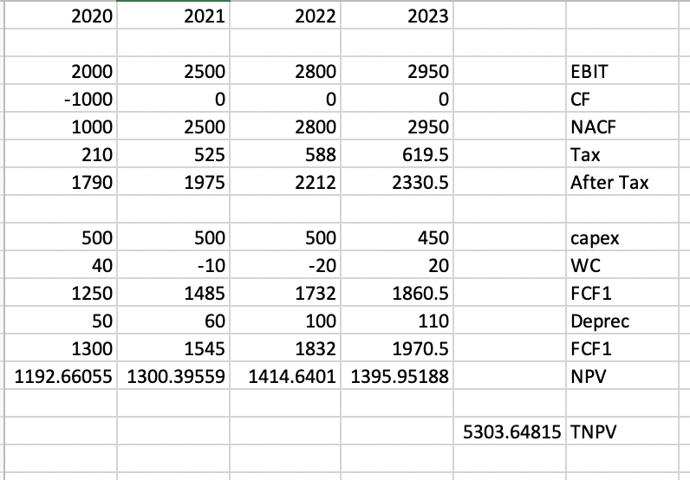
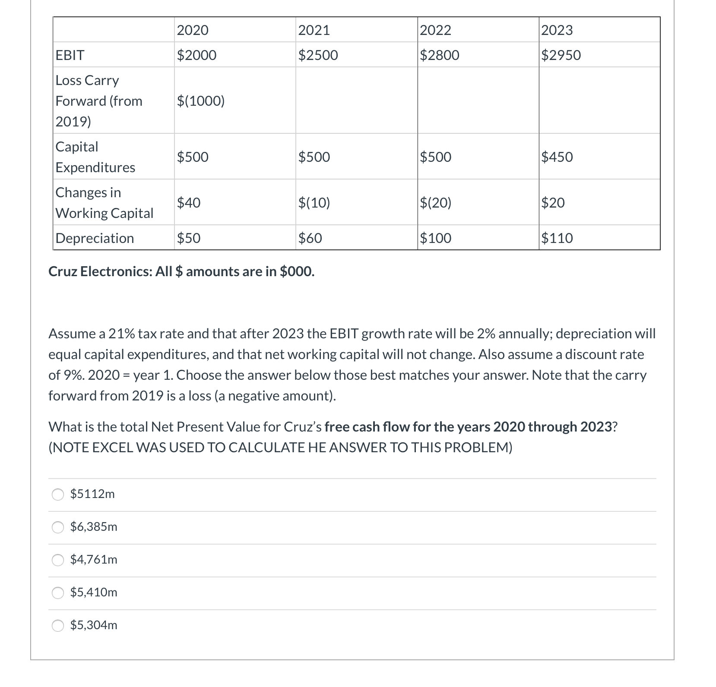
MGT6754 Business Fundamentals for Analytics Video Conference Call #9 FCF with Net Loss Carry Forward
Loss carryforward
Adjusted for LCF
Taxes
Net Income
Capex
Change in WC
Depreciation
Free Cash Flow
Terminal Value = $2950*(1-.21)(1 + .02)
(.09 - .02 )
Terminal Value = $33,958.71
Discounted TV = $33,958/(1.09^4) = $24,057.21
NPV (Fair Market Value) = $5303.64+$24,057.21
= $29,360.85

Slide 4
MGT6754 Business Fundamentals for Analytics Video Conference Call #9 VC Method
Saint Lyonn Equity Partners (“SL Equity”) has made an offer to Blue Mountain Craft Brewers to invest $1,000,000 in their business. SL Equity used the VC Method to establish a market value for Blue Mountain. The valuation is based on projected earnings for Blue Mountain of $3,500,000 in FY2023 (year 4 of the investment) and a 9 earnings multiple. SL Equity is also demanding a 45% ROI. 1) If the deal closes what % ownership of Blue Mountain will be acquired by SL Equity? 2) How many shares will be issue to SL Equity if the current owners have collectively 2,000,000 shares?
Now assume that the Venture Capitalists at Saint Lyonn expect that Blue Mountain will require two more rounds of funding before the company is attractive enough to be purchased by much larger firm – one round in 2021 where an additional 25% of the company will be sold; and a final round in 2022 when an additional 15% share of the company will be sold. 3)What percent ownership should Saint Lyonn Ventures demand today if they plan to remain undiluted by the two future round of funding?
Blue Mountain Valuation in Year 4 = $3.5m * 9 = $31.5m
NPV @45% required ROI = $31.5/1.45^4 =$7.13m
SL Equity Ownership = $1m/$7.13m = 14%
# new shares issued = x/(x+2m) = .14
X = 325,581 shares for SL Equity @ $3.07/share
Pre-money is appx $6.13 million
Retention Ratio = 1/1.25 = .8 for round 2
and 1/1.15 = .8695 for round 3
.14/.8 = .175 for round 2, .175/.8695 = .2012 after round 3
= 20.12% ownership demanded

Slide 5
Business Fundamentals for Analytics Video Conference Call #9 Valuation: Comparison of Valuation Methods
Strength Weaknesses
_____________________________________________________________________________
Comparable Quick to use Private companies
Simple to understand comparable difficult
Commonly used to find
Market based If public company
comparables use
liquidity discount
_____________________________________________________________________________
Discounted Cash Theoretically Sound Cash flows difficult
Flow to estimate
WACC assumes constant
capital structure
Sensitive to terminal
growth assumptions
______________________________________________________________________________
Venture Capital Quick to use Relies on terminal value
Simple to understand from other methods
Commonly used Large discount rates

Slide 6
Business Fundamentals for Analytics Video Conference Call #9 General Questions
Just trying to understand terminal value concept, using a growth in perpetuity example, and using the npv example from the video. It states that terminal value is 2000. This means that sum of all cash flows in the future will be 2000 or does it mean that it will be 2000 each year. If the former, then it means assuming nothing changes for the next 10 years, 100 years, 1000 years or 10000 years all we can hope to get from the company is 2000. If so, what would be the terminal value assuming the company only had 100 year life span? In this case, the concept seems weird to me- because you could never estimate a value for the company at 10 or 20 years?
Knowing what we do now about the build up to the dot-com bubble, are there models out there that can predict or detect "bubbles"? We studied time series data and cusum (control charts) in ISYE 6501. It seems like much of the financial data we have been talking about in this class is time-series in nature. I recall that GARCH was frequently used for financial/business related data. I am just curious if there are models that could be applied to the entire stock market, or to a specific segment of the market (i.e. technology stocks, mortgage related investments, etc.

Slide 7
MGT6754 Business Fundamentals for Analytics Video Conference Call #9 Questions for the Forum
Investors of IPOs are institutional and individual investors. As an individual investor how to invest on IPO? So far I only know how to trade stock via online site such as ameritrade.com, but that is after IPO, right? How to invest before the first day?
Who gets access to the official IPO price? In the case of Facebook, who actually got to buy it for $38? Is it just available to clients with accounts at the Investment Bank that took them public?
About 'leave money on the table’ comment, does it mean the IB/company purposely keep the IPO price lower than the expected after IPO price so that investors can make some money? I guess I am not clear about the idea of 'leave some money on the table’.
Please explain the difference between a VC and a Business Angel. How do exit strategies differ between the two? Regarding VCs what is the expected timeframe for exiting an investment. What happens if an exit occurs after the 10 year “life” of the firm?
Can you describe all the exit options for the VC investor? The presentation talks primarily about IPO. What are the other options for a VC? Can a VC investor sell to other VC who has or has not invested in the company? Will a VC sell back to the owner?

Slide 8
Business Fundamentals for Analytics Video Conference Call #10 Valuation: NPV Reference Slide
CF_{t} = EBIT_{t} * (1-T) +Depr._{t} - CAPEX_{t} - ΔNWC_{t}
CF = Cash Flow
EBIT = Earnings Before Interest and Taxes
T = Corporate Tax Rate
DEPR = Depreciation
CAPEX= Capital Expenditures
ΔNWC = Increase in Net Working Capital
Terminal Value
CF_{T} * (1+g)
TV_{T} = ---------------------
r - g
Typically assume that the WC is zero year over year and that capex = depreciation
CF₁ CF₂ CF₃ CF_{T} + TV_{T}
NPV = ---- + ---- + ----- + …… +-----------
1+r. (1+r)^{2.} (1+r)^{3.} (1+r)^{T}
Notes:
_________________________________________________________________
_________________________________________________________________
_________________________________________________________________
_________________________________________________________________
_________________________________________________________________
_________________________________________________________________
_________________________________________________________________
_________________________________________________________________

